Slide 1

ARTIFICIAL INTELLIGENCE & MACHINE LEARNING
PRESENTED BY:
GROUP 1

Slide 2
PRESENTATION OUTLINE
PROBLEM STATEMENT
INTRODUCTION
METHODOLOGY
OUTPUT/RESULT

Slide 3
PROBLEM STATEMENT
Employee attrition is a major challenge that impacts productivity and increases hiring costs. This project aims to predict whether an employee is likely to leave the company using IBM HR Analytics data.
This project uses dataset created by IBM that includes various employee factors like job satisfaction, education, income, work-life balance, and more. The goal is to use machine learning to predict attrition and gain insights that can help improve employee retention.
The goal is to enable data-driven retention strategies and improve workforce stability.

Slide 4
INTRODUCTION
This project uses IBM's HR Analytics dataset to develop a machine learning model that predicts whether an employee is likely to leave the company.We aim to uncover the key drivers of attrition and support HR teams in making informed, decisions by various features:
Job satisfaction, education, income, work-life balance, environment satisfaction, job involvement, performance rating, relationship satisfaction.

Slide 5
PROJECT OBJECTIVES
Create a model that can predict if an employee will leave the company or not.
Use and compare different machine learning methods like Logistic Regression, Decision Trees, and Random Forest.
Show which employee details (like salary, job role, etc.) matter most in predicting attrition.
Give useful suggestions to help HR teams keep valuable employees and reduce turnover.

Slide 6
METHODOLOGY
3.MODEL BUILDING
2.DATA PREPOCESSING
1.DATA COLLECTION
4.MODEL EVALUATION

Slide 7
1.DATA COLLECTION
For this project, we used dataset created by IBM data scientists called the IBM HR Analytics Employee Attrition Dataset. This dataset is commonly used for studying HR analytics and machine learning applications.
The dataset includes over 1,400 employee records.
Each record contains multiple features related to:
Personal details
Job-related information
Satisfaction scores
Performance metrics
Target Variable:
Attrition (Yes/No) – This is what we are trying to predict.

Slide 8
2.DATA PREPROCESSING
Before building any machine learning model, it’s important to clean and prepare the data.
Checked for missing values – none were found in this dataset.
Converted categorical variables into numerical format for model training.
For example:
Education levels (1 = 'Below College', 5 = 'Doctor')
WorkLifeBalance (1 = 'Bad', 4 = 'Best')
Removed columns like EmployeeNumber and EmployeeCount, which do not impact attrition.

Slide 9
3.MODEL BUILDING
We selected several popular classification algorithms to compare their performance, including:
Logistic Regression
Decision Tree
Random Forest
The dataset was split into training and testing sets (commonly 70% training and 30% testing).

Slide 10
4.MODEL EVALUATION
ACCURACY
The percentage of total correct predictions (both employees who left and stayed).
PRECISION
Measures how many employees predicted to leave actually left.
RECALL
Measures how many actual employees who left were correctly identified by the model.
F1 SCORE
Harmonic mean of precision and recall, providing a balance between the two.
CONFUSION MATRIX
A table showing true positives, true negatives, false positives, and false negatives.

Slide 11
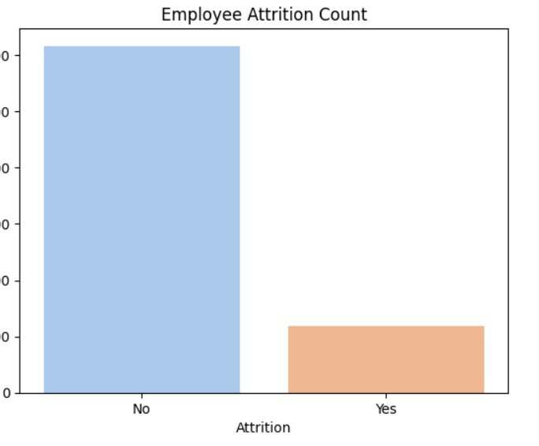
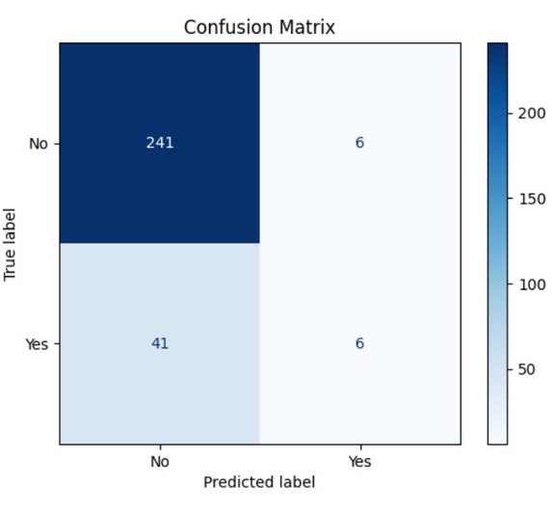
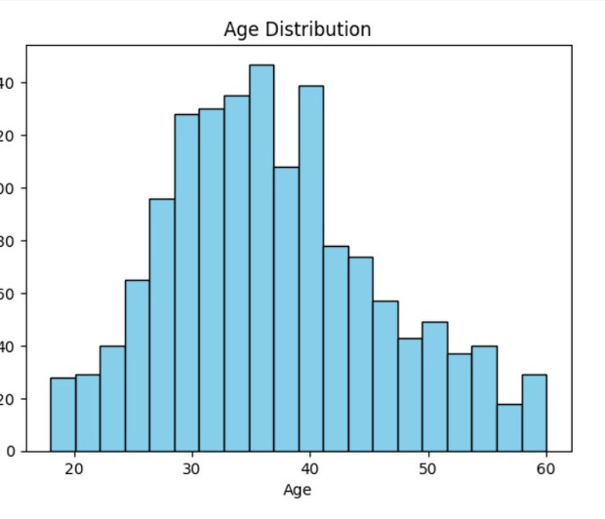
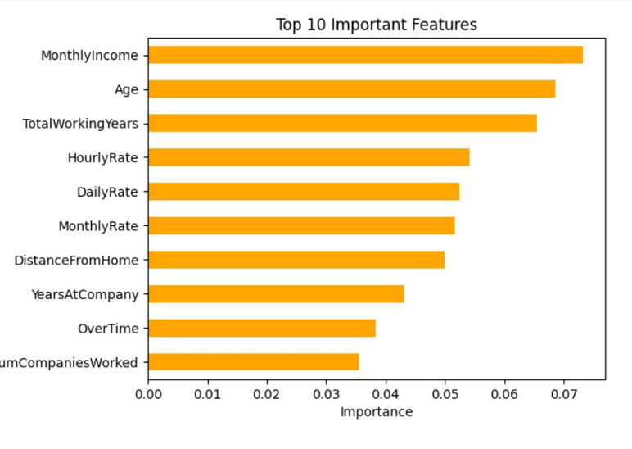
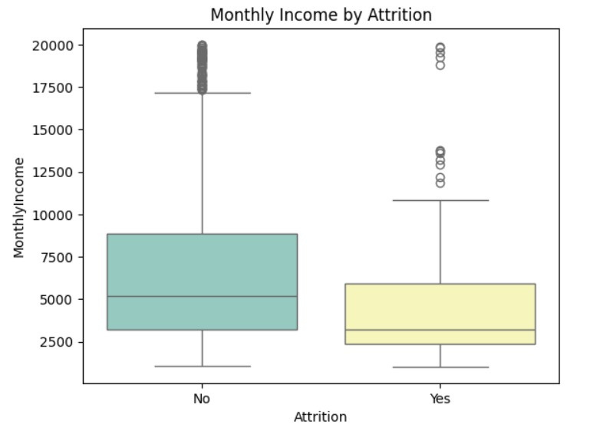
RESULT:

